Slide 1
Project Presentation of Co-Op Project at Industry (Module-2)
On
GameVerse
Aayush Goel, Tanisha, Keshav Garg, Bhavik Gaba
2210991136, 2210990891, 2210991782, 2210991438
Supervised By
Dr. Rajat Takkar
Department of Computer Science and Engineering,
Chitkara University, Punjab

Slide 2
Introduction
Overview:
In today’s digital environment, multiplayer gaming and interactive events are becoming increasingly popular in organizations and educational institutions. However, most activities are still limited to repetitive quiz-based games, which gradually reduce user engagement and excitement.
Additionally, existing gaming platforms often focus on a single game or fail to handle real-time interaction efficiently. Issues such as lag, delayed updates, lack of proper host controls, and poor synchronization affect the overall experience and make gameplay less enjoyable.
To address these challenges, we developed GameVerse, a centralized real-time gaming platform that brings multiple games under one system. It allows users to play different types of games in both online and offline modes while ensuring smooth performance, fairness, and proper coordination.
The platform is designed to improve engagement, provide better control to hosts, and create a more interactive and structured gaming experience for users.
‹#›

Slide 3
Technology Used
Backend Framework: ASP.NET Core is used to handle server-side logic, manage game flow, process bids, and ensure secure and efficient API communication with high performance.
Frontend Framework: Angular is used to build a dynamic and interactive user interface using component-based architecture, routing, and structured design.
Database: SQL database with Entity Framework is used to store user details, team data, bids, chat messages, and game states while maintaining consistency and reliability.
Real-Time Communication: SignalR is used for real-time communication, enabling instant updates for bidding, chat, and game events without page refresh.
Architecture: A Client-Server architecture is followed, ensuring smooth communication between frontend and backend along with scalability.
Deployment: The application is deployed using Docker and free hosting solutions, making the system cost-effective and easy to scale.

Slide 4
Problem Statement And Objective
Problem Statement:
Existing gaming systems lack variety, real-time performance, and proper management tools. Most platforms either suffer from lag or support only one type of game.
In organizational events, repeated use of quiz games reduces engagement. Additionally, there is no structured, scalable, and cost-free solution for hosting multiplayer games with fairness and synchronization.
Objectives:
Build a centralized platform for multiple games
Enable real-time multiplayer interaction using SignalR
Provide host-controlled gameplay
Ensure fairness through validation and synchronization
Create a scalable and cost-efficient solution
Protect originality of game logic

Slide 5
Implementation
Gathered requirements based on real-world gaming events and designed a room-based architecture for multiplayer interaction
• Developed frontend using Angular, creating components for dashboard, room creation/joining, and game interfaces
• Built backend using ASP.NET Core to manage game logic, players, teams, bids, and score tracking
• Integrated SignalR for real-time communication, enabling instant bidding, chat, and game updates across all users
• Implemented separate modules for games including Sarkaar, Imposter, and Tambola, each with its own logic
• Added validation mechanisms to prevent duplicate actions, ensure fairness, and maintain synchronization
• Tested the system for performance, accuracy, and smooth real-time interaction with multiple users

Slide 6
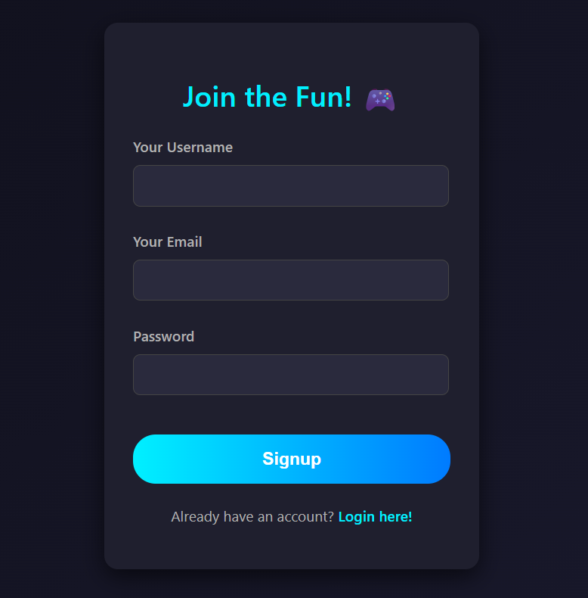
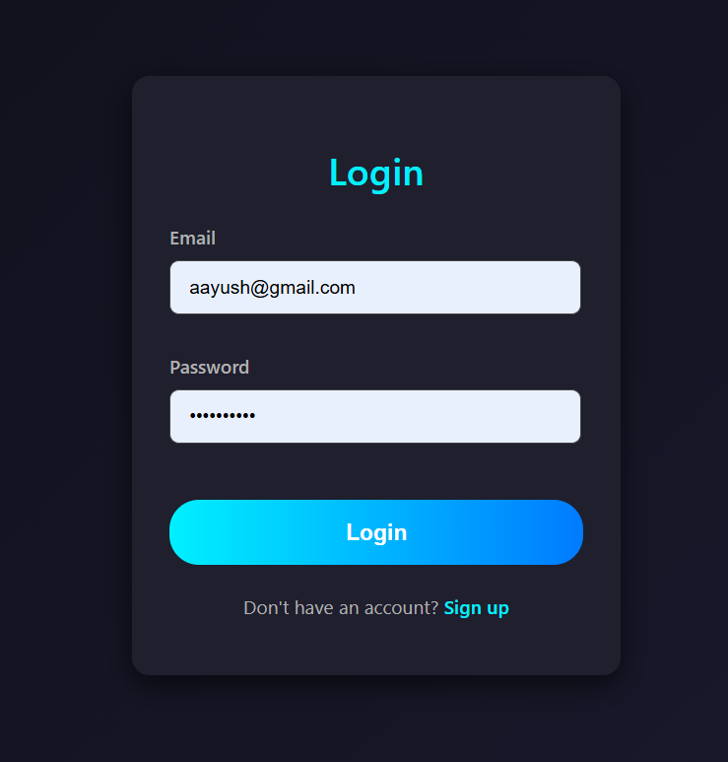
UI Design
LOGIN / SIGNUP

Slide 7
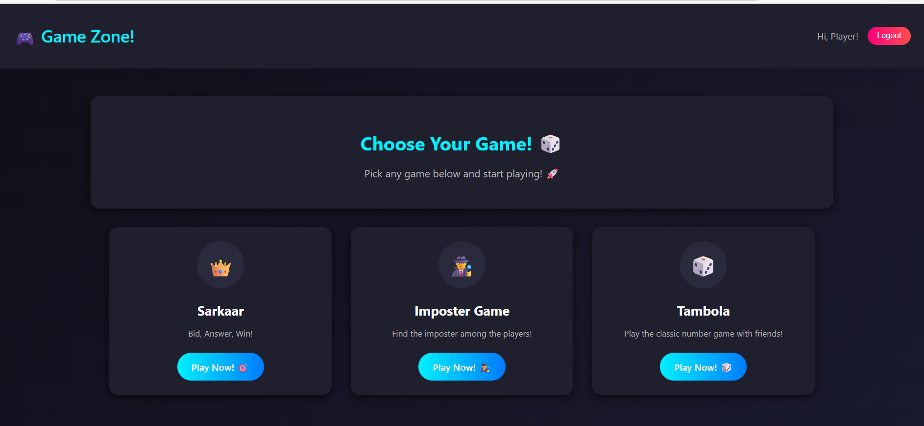
UI Design
Home Page

Slide 8
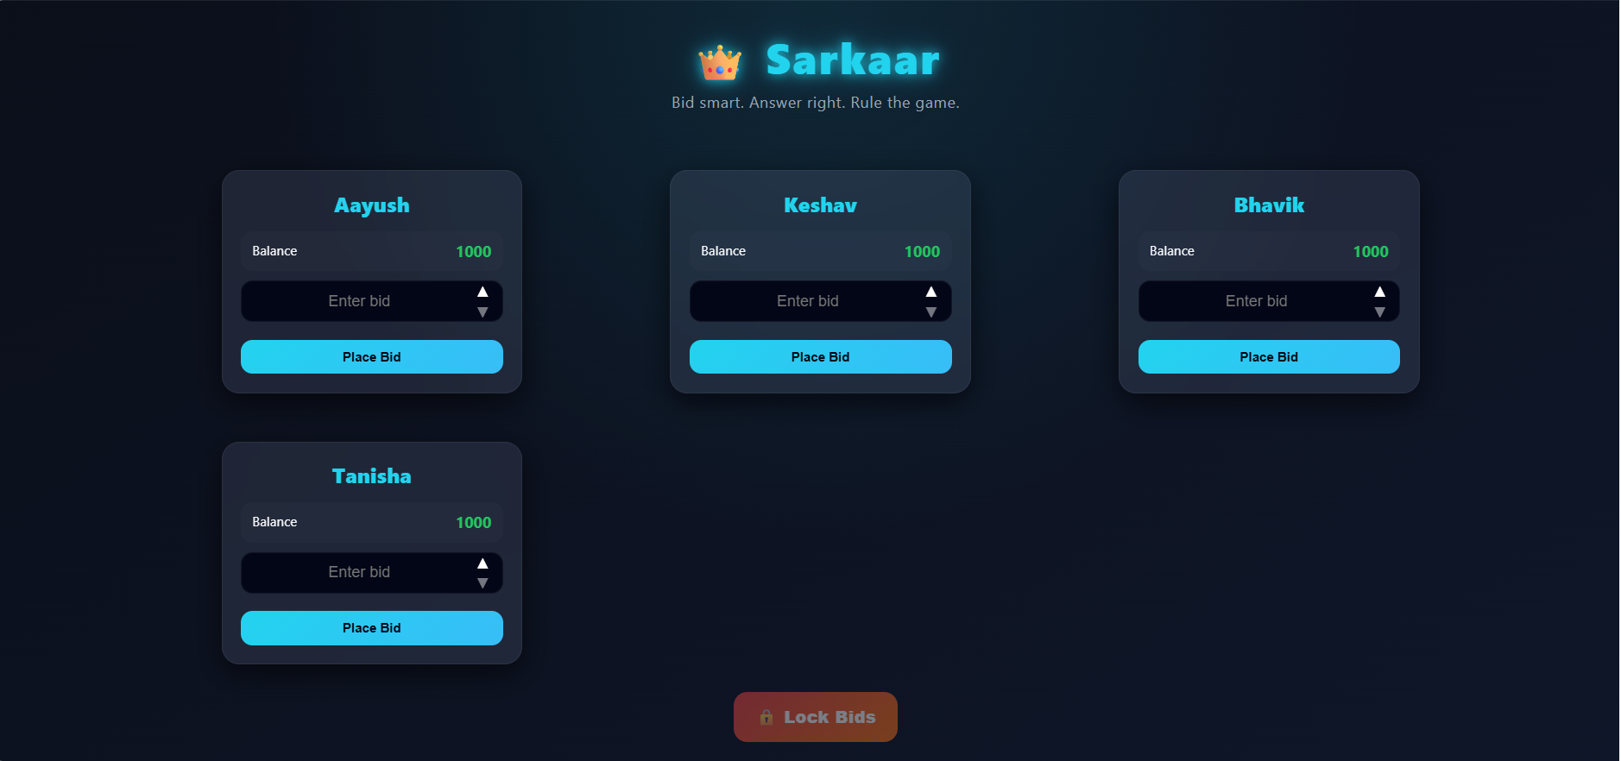
UI Design
Sarkaar Game

Slide 9
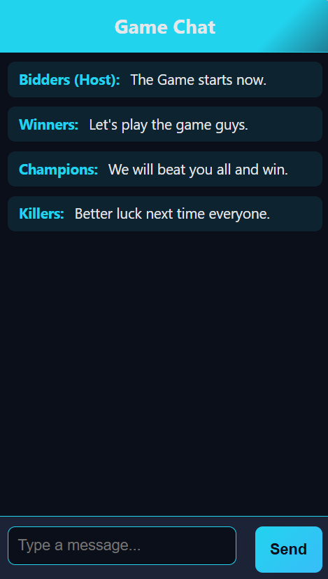
UI Design
Game Chat

Slide 10
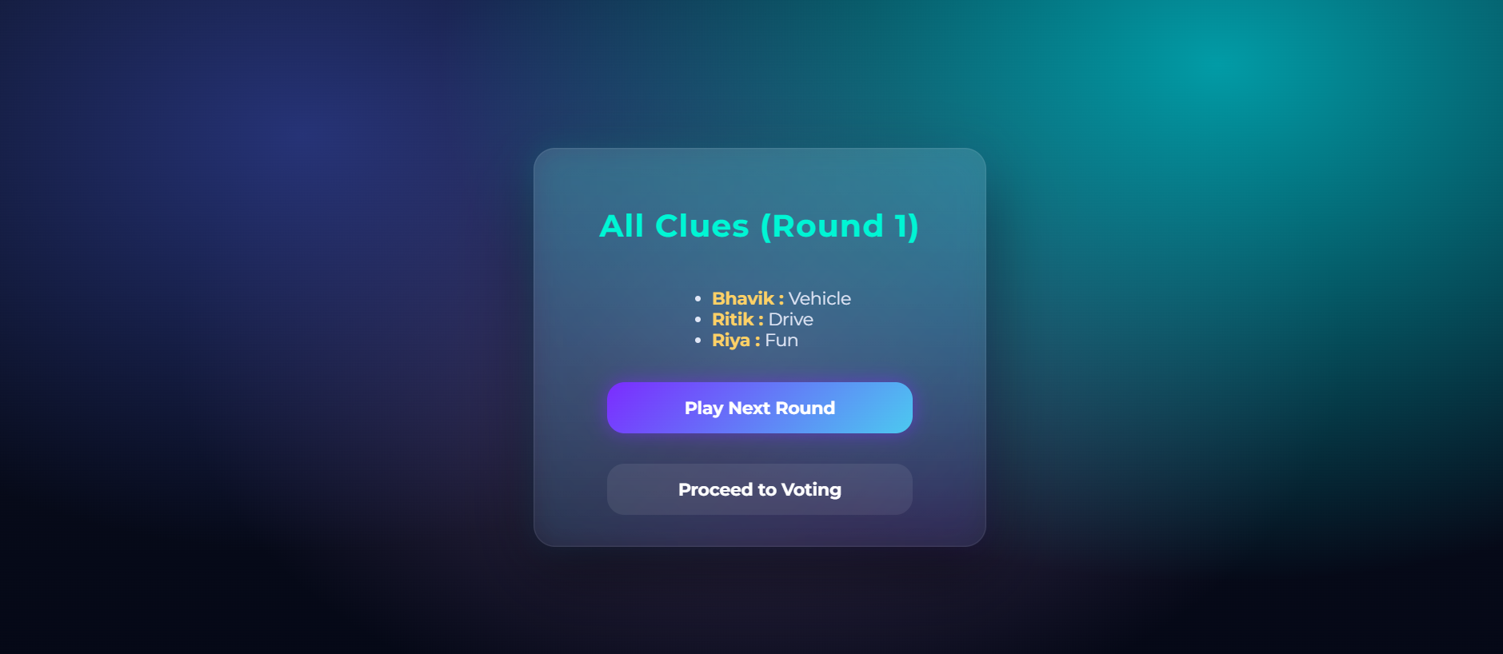
UI Design
Imposter Game

Slide 11
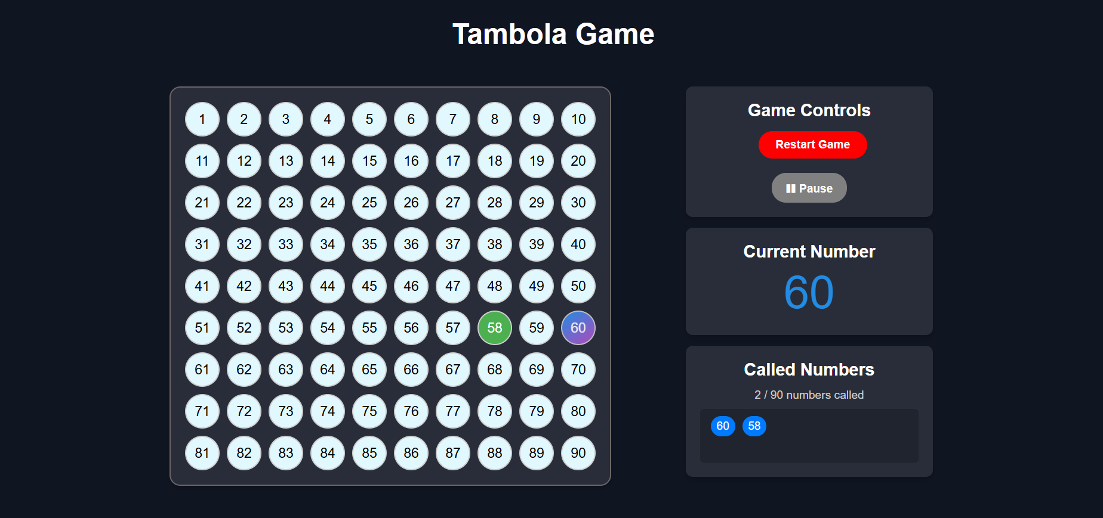
UI Design
Tambola Game

Slide 12
Result
Developed a centralized gaming platform where multiple games can be played in one system
• Achieved real-time interaction using SignalR, ensuring instant updates for bids, chat, and game events
• Improved user engagement by replacing repetitive quiz-based activities with interactive games
• Ensured fair gameplay through validation mechanisms and controlled bidding system
• Provided smooth and synchronized gameplay experience for multiple users simultaneously
• Built a cost-free solution with no additional expense for hosting or database
• Created a scalable system that can support increasing number of users and games

Slide 13
Conclusion
The GameVerse project successfully provides a centralized and interactive platform for hosting multiple real-time multiplayer games within a single system. It effectively addresses the limitations of traditional gaming methods by replacing repetitive activities with engaging and diverse gameplay experiences.
By integrating modern technologies such as Angular, ASP.NET Core, and SignalR, the platform ensures smooth performance, real-time communication, and proper synchronization among all players. The room-based architecture along with host controls helps maintain fairness, structured gameplay, and better management of game sessions.
Overall, the system improves user engagement, enhances collaboration among participants, and offers a scalable and cost-effective solution for conducting gaming events in organizations and educational environments. It also demonstrates how real-time systems can be efficiently designed and implemented for practical use.

Slide 14
Reference
Angular Official Documentation – Frontend development and component-based architecture
ASP.NET Core Documentation – Backend development and API implementation
SignalR Documentation – Real-time communication and WebSocket integration
Entity Framework Documentation – Database handling and data management
Docker Documentation – Deployment and containerization
Research articles and online resources on real-time multiplayer systems and game architecture

Slide 15
Thank You
‹#›

